Slide 1
WoT Intro and Update
Michael McCool, Intel

Slide 2
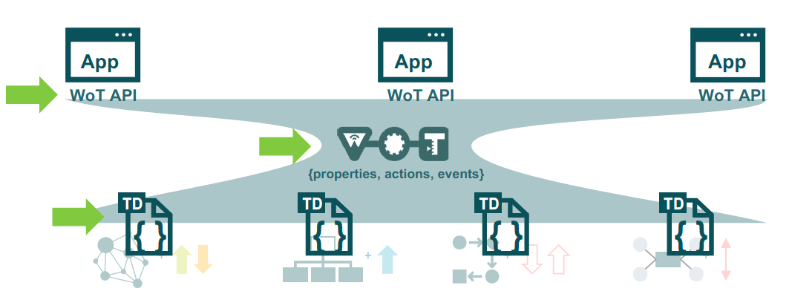
W3C Web of Things (WoT)
W3C Working Group: goal is adapting web technologies to IoT
Recently published: standard Thing Description (TD) metadata format
TD describes the available interactions (network API) of a Thing
New standards work includes discovery
How does a potential client obtain the TDs for a Thing?

Slide 3

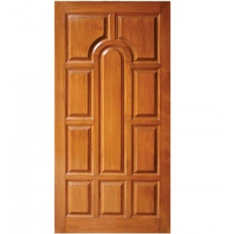

WoT Descriptive Interoperability
WoT Architecture
Constraints
Things must have TD (W3C WoT)
Must use hypermedia controls (general WoT)
URIs, standard set of methods, media types
Interaction Affordances
TD describes the possible choices (what) to Consumers, suggests how Consumers may interact with the Thing
WoT Thing Description (TD)
{
"@context": [
"https://www.w3.org/2019/wot/td/v1",
{ "iot": "http://iotschema.org/" }
],
"id": "urn:dev:org:32473:1234567890",
"title": "MyLEDThing",
"description": "RGB LED torchiere",
"@type": ["Thing", "iot:Light"],
"securityDefinitions": ["default": {
"scheme": "bearer"
}],
"security": ["default"],
"properties": {
"brightness": {
"@type": ["iot:Brightness"],
"type": "integer",
"minimum": 0,
"maximum": 100,
"forms": [ ... ]
}
},
"actions": {
"fadeIn": {
...
Pull
Handle = Affordance
What?
How?
Door = Thing
Open
Turn

Slide 4
Use Case Overview

Slide 5
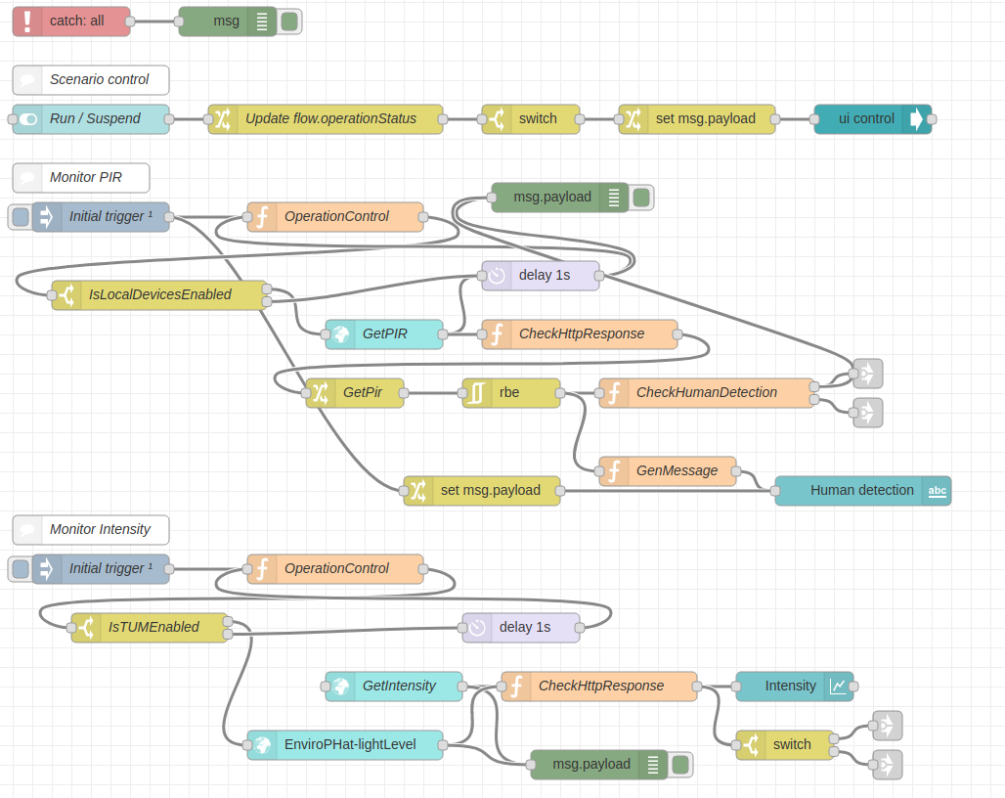

WoT Orchestration
node-wot/Scripting API
Node-RED/node-gen
WoTHelpers.fetch( "coap://localhost:5683/counter" ).then( async (td) => {
// using await for serial execution (note 'async' in then() of fetch())
try {
let thing = await WoT.consume(td);
console.info( "=== TD ===" );
console.info(td);
console.info( "==========" );
// read property #1
let read1 = await thing.readProperty( "count" );
console.info( "count value is" , read1);
// increment property #1 (without step)
await thing.invokeAction( "increment" );
let inc1 = await thing.readProperty( "count" );
console.info( "count value after increment #1 is" , inc1);
// increment property #2 (with step)
await thing.invokeAction( "increment" , {'step' : 3});
let inc2 = await thing.readProperty( "count" );
console.info( "count value after increment #2 (with step 3) is" , inc2);
// decrement property
await thing.invokeAction( "decrement" );
let dec1 = await thing.readProperty( "count" );
console.info( "count value after decrement is" , dec1);
} catch(err) {
console.error( "Script error:" , err);
}
}).catch( (err) => { console.error( "Fetch error:" , err); });
WoT TD benefit: Module autopopulation

Slide 6
New WoT WG Charter Work Items
Architectural Requirements, Use Cases, and Vocabulary
Understand and state requirements for new use cases, architectural patterns, and concepts.
Link Relation Types:
Definition of specific link relation types for specific relationships.
Observe Defaults:
For protocols such as HTTP where multiple ways to implement "observe" is possible, define a default.
Implementation View Spec:
More fully define details of implementations.
Interoperability Profiles:
Support plug-and-play interoperabilty via a profile mechanism
Define profiles that allow for finite implementability
Thing Description Templates:
Define how Thing Descriptions can defined in a modular way.
Complex Interactions:
Document how complex interactions can be supported via hypermedia controls.
Discovery:
Define how Things are discovered in both local and global contexts and Thing Descriptions are distributed.
Identifier Management:
Mitigate privacy risks by defining how identifiers are managed and updated.
Security Schemes:
Vocabulary for new security schemes supporting targeted protocols and use cases.
Thing Description Vocabulary:
Extensions to Thing Description vocabulary definitions.
Protocol Vocabulary and Bindings:
Extensions to protocol vocabulary definitions and protocol bindings.

Slide 7
W3C WoT Resources
W3C WoT Wiki
https://www.w3.org/WoT/IG/wiki (IG/WG organizational information)
W3C WoT Interest Group
https://www.w3.org/2016/07/wot-ig-charter.html (old charter)
https://www.w3.org/2019/10/wot-ig-2019.html (new charter)
https://lists.w3.org/Archives/Public/public-wot-ig/ (mailing list)
https://github.com/w3c/wot (technical proposals)
W3C WoT Working Group
https://www.w3.org/2016/12/wot-wg-2016.html (old charter)
https://www.w3.org/2020/01/wot-wg-charter.html (new charter)
https://www.w3.org/WoT/WG/ (dashboard)
W3C WoT Candidate Recommendations
https://www.w3.org/TR/wot-architecture/
https://www.w3.org/TR/wot-thing-description/
W3C WoT Working Drafts / Group Notes
https://www.w3.org/TR/wot-binding-templates/
https://www.w3.org/TR/wot-scripting-api/
https://www.w3.org/TR/wot-security/
W3C WoT Editors’ Drafts and Issue Tracker
https://github.com/w3c/wot-architecture/
https://github.com/w3c/wot-thing-description/
https://github.com/w3c/wot-binding-templates/
https://github.com/w3c/wot-scripting-api/
https://github.com/w3c/wot-security/
https://github.com/w3c/wot-security-best-practices/
https://github.com/w3c/wot-profile/
Reference Implementations and Tools: node-wot
node-wot: https://github.com/eclipse/thingweb.node-wot
TD playground: https://github.com/thingweb/thingweb-playground

Slide 8
Contacts
https://www.w3.org/WoT/WG/
Dr. Michael McCool
Principal Engineer
Intel
Technology Pathfinding
michael.mccool@intel.com
Dr. Sebastian Kaebisch
Research Scientist
Siemens
Corporate Technology
sebastian.kaebisch@siemens.com

